Slide 1
Defining classes
Principles of programming

Slide 2
Introduction
In this chapter we will understand how to define custom classes and their elements. We will learn to declare fields, constructors and properties for the classes.
We will revise what a method is and we will broaden our knowledge about access modifiers and methods.
We will observe the characteristics of the constructors and we will set out how the program objects coexist in the dynamic memory and how their fields are initialized.
Finally, we will explain what the static elements of a class are – fields (including constants), properties and methods and how to use them properly.
In this chapter we will also introduce generic types (generics), enumerated types (enumerations) and nested classes.

Slide 3
Custom Classes
The aim of every program written by the programmer is to solve a given
problem based on the implementation of a certain idea. In order to create a
solution, first, we sketch a simplified actual model, which does not represent
everything, but focuses on these facts, which are significant for the end
result. Afterwards, based on the sketched model, we are looking for an
answer (i.e. to create an algorithm) for our problem and the solution we
describe via given programming language.

Slide 4
Custom Classes
Nowadays, the most used programming languages are the object-oriented.
And because the object-oriented programming (OOP) is close to the way
humans think, using one easily allows us to describe models of the
surrounding life. Certain reason for this behavior is, because OOP offers tools
to draw the set of concepts, which outline classes of objects in every model.
The term – class and the definition of custom classes, different from the .NET
system framework’s, is built-in feature of the C# programming language. The
purpose of this chapter is to get us know with it.

Slide 5
What Does It Mean Class and Object?
Class in the OOP is called a definition (specification) of a given type of
objects from the real-world. The class represents a pattern, which describes
the different states and behavior of the certain objects (the copies), which are
created from this class (pattern).

Slide 6
What Does It Mean Class and Object?
Object is a copy created from the definition (specification) of a given class, also called an instance. When one object is created by the description of one class we say the object is from type "name of the class".
For example, if we have a class type Dog, which describes some of the characteristics of a real dog, then, the objects based on the description of the class (e.g. the doggies "Fido" and "Rex") are from type class Dog. It means the same when the string "some string" is from class type String.
The difference is that objects from type Dog is are copies of the class, which is not part of the system library classes of the .NET Framework, but defined by ourselves (the users of the programming language).

Slide 7
What Does a Class Contain?
Every class contains a definition of what kind of data types and objects has in order to be described. The object (the certain copy of this class) holds the actual data. The data defines the object’s state.
In addition to the state, in the class is described the behavior of the objects. The behavior is represented by actions, which can be performed by the objects themselves.
The resource in OOP, through which we can describe this behavior of the objects from a given class, is the declaration of methods in the class body

Slide 8
Elements of the Class
Class declaration – this is the line where we declare the name of the class
Class body – similar to the method idioms in the language, the classes also have single class body. It is defined right after the class declaration, enclosed in curly brackets "{" and "}". The content inside the brackets is known as body of the class. The elements of the class, which are numbered below, are part of the body.
Constructor – it is used for creating new objects.
Fields – they are variables, declared inside the class (somewhere in the literature are known as member-variables). The data of the object, which these variables represent, and are retained into them, is the specific state of an object, and one is required for the proper work of object’s methods. The values, which are in the fields, reflect the specific state of the given object, but despite of this there are other types of fields, called static, which are shared among all the objects.

Slide 9
Elements of the Class
Properties – this is the way to describe the characteristics of a given class. Usually, the value of the characteristics is kept in the fields of the object. Similar to the fields, the properties may be held by certain object or to be shared among the rest of the objects.
Methods – from the chapter "Methods" we know that methods are named blocks of programming code. They perform particular actions and through them the objects achieve their behavior based on the class type. Methods execute the implemented programming logic (algorithms) and the handling of data.

Slide 10
Sample Class - Dog

Slide 11
How to Use a Class Defined by Us (Custom Class)?
In order to be able to use a given class, first we need to create an object of it.
This is done by the reserved word new in combination with some of the
constructors of the class. This will create an object from a given class (type).
If we want to manipulate the newly created object, we will have to assign it to
a variable from its class type. By doing it, in this variable we will keep the
connection (reference) to the object.
Using the variable, and the “dot” notation, we can call the methods and the
properties of the object, and as well as gain access to the fields (member variables).

Slide 12
Example – A Dog Meeting

Slide 13
Nature of Objects
Let’s revise, when we create an object in .NET, one consists from two parts –
the significant part (data), which contains its data and it is located in the
memory of the operating system called a dynamic memory (heap) and a
reference part to this object, which resides in the other part of the operating
system’s memory, where are stored the local variable and parameters of the
methods (the program execution stack).
For example, let’s have a class called Dog, which has the properties for name,
kind and age. Let’s create a variable dog from this class. This variable is a
reference to the object and is in the dynamic memory (heap).

Slide 14
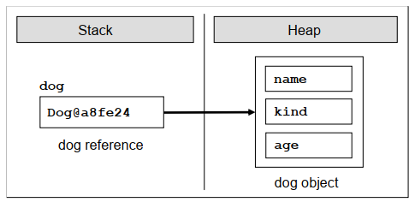
Nature of Objects
The reference is a variable, which can access objects. The figure below
depicts an example reference, which has link to the real object in the heap,
and is called with the name dog. One, compare to the variable from primitive
(value type), does not contain the real value (i.e. the data of the object), but
the address, where one is located in the heap memory:

Slide 15
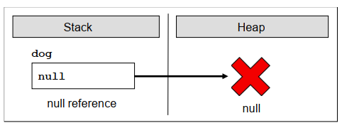
Nature of Objects
When we declare one variable from type a particular class, and we do not
want the variable to be associated with a specific object, then we assign to it
the value null. The reserved word null in the C# language means, that the
variable does not point to any object (there is a missing value)

Slide 16
Organizing Classes in Namespaces
If we want to include in our code namespaces for the operation in our classes, declared in some file or set of files, this should be done by the so named using directives. They are not required, but if they exist, they are on the first lines in the class file, before the declaration of the classes or other types.
In the next paragraphs we will understand how they exactly are used. After the insertion of the used namespaces, the next is the declaration of the namespace of the classes in the file. As we know, there is no requirement to declare classes in a namespace, but it is a good programming technique if we do it, because the class distribution in the namespace is used for better organization of the code and determination of the classes with equal names.
The namespaces contain classes, structure, interfaces and other types of data, and as well other namespaces. An example of nested namespace is System, which contains the namespace Data. The full name of the second namespace is System.Data and one is nested in the namespace System

Slide 17

Organizing Classes in Namespaces
The full name of a class in .NET Framework is the class name, preceded by the namespace in which the class is declared, e.g.: <namespace_name>. <class_name>. By the using reserved word we can use types from certain namespace, without writing the full name, e.g.:

Slide 18
Modifiers and Access Levels (Visibility)
As we explained, in C# there are four access modifiers – public, private, protected and internal. Based on them we control the access (visibility) to the elements of the class, in front of which they are used.
The levels of access in .NET are public, protected, internal, protected internal and private.

Slide 19
Access Level "public"
When we use the modifier public in front of some element, we are telling the
compiler, that this element can be accessed from every class, no matter
from the current project (assembly), from the current namespace.
The access level public defines the miss of restrictions regarding the visibility. This
access level is the least restricted access level in C#.

Slide 20
Access Level "private"
The access level private is the one, which defines the most restrictive level of visibility of the class and its elements.
The modifier private is used to indicate, that the element, to which is issued, cannot be accessed from any other class (except the class, in which it is defined), even if this class
exists in the same namespace.
This is the default access level, i.e. it is used when there is no access level modifier in front of the respective element of a class (this is true only for elements inside a class).

Slide 21
Access Level "internal"
The modifier internal is used to limit the access to the elements of the class only to files from the same assembly, i.e. the same project in Visual Studio.
When we create several projects in Visual Studio, the classes from will be compiled in different assemblies.

Slide 22
Assembly
NET assemblies are collections of compiled types (classes and other types) and resources, which form a logical unit.
Assemblies are stored in a binary file of type .exe or .dll. All types in C# and as general in .NET
Framework can reside only inside assemblies.
By every compilation of a .NET application one or several assemblies are created by the C# compiler and each assembly is stored inside an .exe or .dll file.

Slide 23
Class Naming Convention
Equal to the methods, for creation of the class names there are the following common standards:
The names of the classes begin with capital letter, and the rest of the letters are lower case. If the name of the class consists of several words, every word begins with capital letter, without separator to be used. This is the well-known PascalCase convention.
For name of the classes nouns are usually used.
It is recommended the name of the class to be in English language.
Here are some example class names, which are following the guidelines:
Dog
Account
Car
BufferedReader

Slide 24
The Reserved Word "this"
The reserved word this in C# is used to reference the current object, when one is used from method in the same class. This is the object, which method or constructor is called. The reserved word can be deemed as an address (reference), given priory from the language authors, with which we access the elements (fields, methods, constructor) of the own class:
this.myField; // access a field in the class
this.DoMyMethod(); // access a method in the class
this(3, 4); // access a constructor with two int parameters
Currently, we will not explain the given code above. Later, we will do it in other sections of this chapter, dedicated to the elements of the class (fields, methods, constructors) and as well related to the reserved word this.

Slide 25
Fields
Objects describe things from the real world. In order to describe an object, we focus on its characteristics, which are related to the problems solved in our program.
These characteristics of the real-world object we will hold in the declaration of the class in special types of variables.
These variables, called fields (or member-variables), are holding the state of the object.
When we create an object based on certain class definition, the values of the fields are containing the characteristics of the created object (its state).
These characteristics have different values different for the different objects.

Slide 26
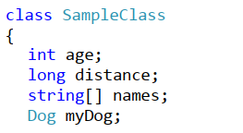
Declaring Fields in a Class
Fields are declared in the body of the class, outside the body of a single method or constructor.
Fields are declared in the body of the class but not in the bodies of the methods or the constructors.
The scope of a class field starts from the line where is declared and ends at the closing bracket of the body of the class.

Slide 27
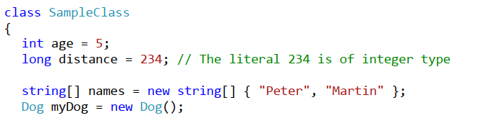
Initialization during Declaration
When we declare one field it is possible to assign to it an initial value. We do this similarly to an assignment of normal local variable:

Slide 28
Default Values of the Fields
Every time, when we create a new object of a given class, it is allocated memory in the heap for every field from the class. In order this to be done the memory is initialized automatically with the default values for the certain field. The fields, which do not have explicitly a default value in the code, use the default value specified for the .NET type, to which they belong.
This is different for the local variables defined in methods. If a local variable in a method does not have a value assigned, the code will not compile. If a member variable (field) in a class does not have a value assigned, it will be automatically zeroed by the compiler.

Slide 29
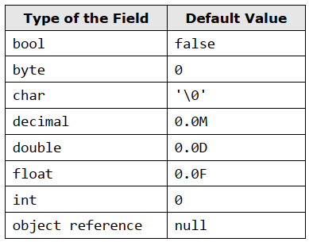
Default Values of the Fields

Slide 30
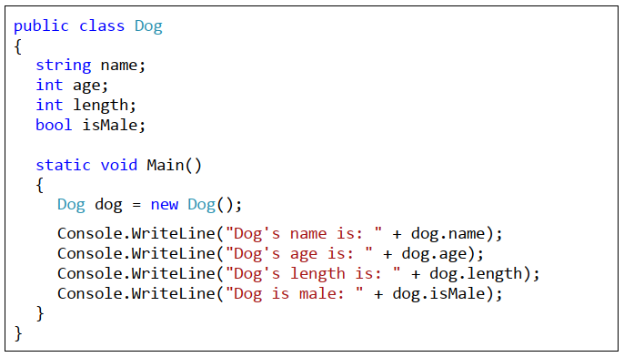
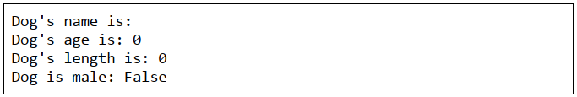
Default Values of the Fields

Slide 31
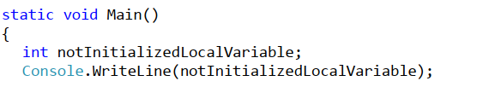
Automated Initialization of Local Variables and Fields
If we define a local variable in one method, without initializing it, and afterward we try to use it (e.g. printing its value), this will trigger a compilation error, because the local variables are not initialized with default values when they are declared.
Unlike fields, local variables are not initialized with default values when they are declared.

Slide 32
Automated Initialization of Local Variables and Fields
If we define a local variable in one method, without initializing it, and afterward we try to use it (e.g. printing its value), this will trigger a compilation error, because the local variables are not initialized with default values when they are declared.
Unlike fields, local variables are not initialized with default values when they are declared.

Slide 33
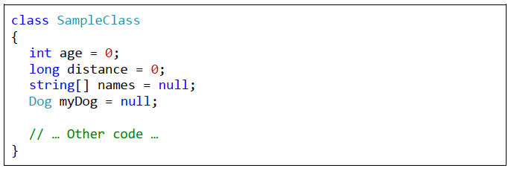
Custom Default Values
A good programming practice is, when we declare fields in the class, to explicitly initialize them with some default value, even if the default value is zero.
This will make our code clearer and easy to read.

Slide 34
Modifiers "const" and "readonly"
In the declaration of one field is allowed to use the modifications const and readonly.
The fields, declared as const or readonly are called constants.
They are used when a certain value is used several times.
These values are declared only ones without repetitions.
Examples of constants in the .NET Framework are the mathematical constants Math.PI and Math.E, and as well the constants String.Empty and Int32.MaxValue.

Slide 35
Constants Based on "const"
The fields, declared with const, have to be initialized during the de facto declaration and afterwards theirs value cannot be changed.
They can be accessed without to create an instance (an object) of the class and they are common for all created objects in our program.
Something more, when we compile the code, the places where const fields are referred are replaced with theirs particular values directly without to use the constant variable at all.
For this reason the const fields are called compile-time constants, because they are replaced with the value during the compilation process.

Slide 36
Constants Based on "readonly"
The modifier readonly creates fields, which values cannot be changed once they are assigned.
Fields, declared as readonly, allow one-time initialization either in the moment of the declaration or in the class constructors.
Later theirs values cannot be changed.
Because of this reason, the readonly fields are called run-time constants – constants, because their values cannot be changed after assignment and run-time, because this process happens during the execution of the program (in runtime).

Slide 37
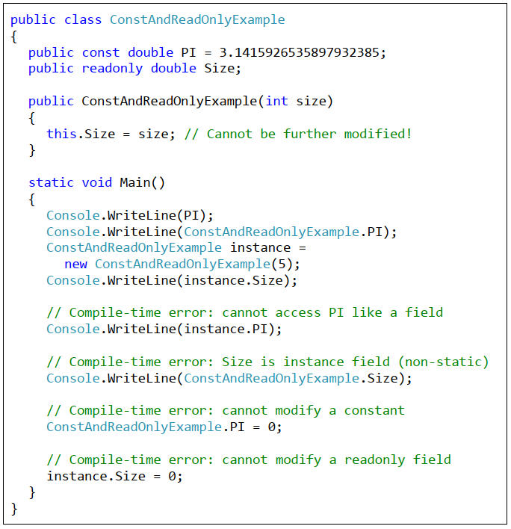
Constants - Example

Slide 38
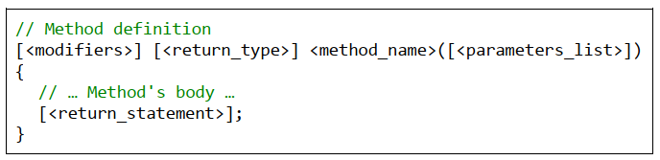
Declaring of Class Method
The mandatory elements for declaration of a method are the type of the return value <return_type>, the name of the method <method_name> and the opening and the closing brackets – "(" and ")".
The parameter list <params_list> is not mandatory. We use it to pass data to the method, which we declare, when this is required.
If the return type <return_type> is void, then <return_statement> can be declared without the return statement. If <return_type> is different from void, the method has to return a result with the help of the reserved word return and an expression, which is from the type <return_type> or a compatible one.
The work, which the method has to do, is situated in the method body, enclosed in curly brackets – "{" and "}".

Slide 39
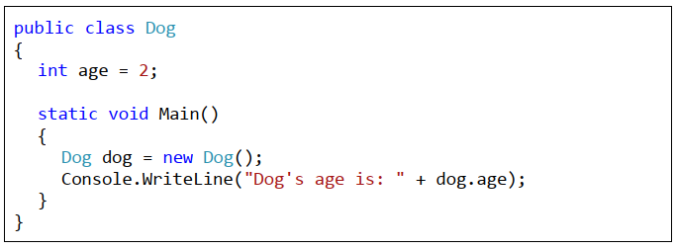
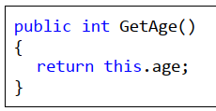
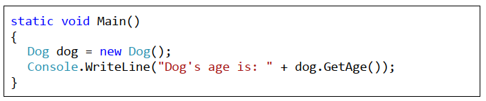
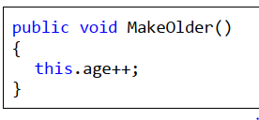

Accessing Non-Static Data of the Class

Slide 40
Visibility of Fields and Methods
Access Level "public“
When a method or a value of a class is declared with access level public, the last can be used from other classes, independently from the fact if another class is declared in the same namespace, assembly or outside of it.
Access Level "internal“
When a member of some class is declared with access level internal, then this element from the class can be accessed from every class in the same assembly (i.e. in the same project in Visual Studio), but not from classes outside it (i.e. from other projects in Visual Studio – from the same solution or from a different solution).
Access Level "private“
The access level, which is the most restrictive, is private. The elements of the class, which are declared with access modifier private (or without any, because private is the default one), cannot be accessed outside of the class in which they are declared.

Slide 41
Constructors
In object-oriented programming, when creating an object from a given class, it is necessary to call a special method of the class known as a constructor.
What Is a Constructor?
Constructor of a class is a pseudo-method, which does not have a return type, has the name of the class and is called using the keyword new. The task of the constructor is to initialize the memory, allocated for the object, where its fields will be stored (those which are not static ones)

Slide 42
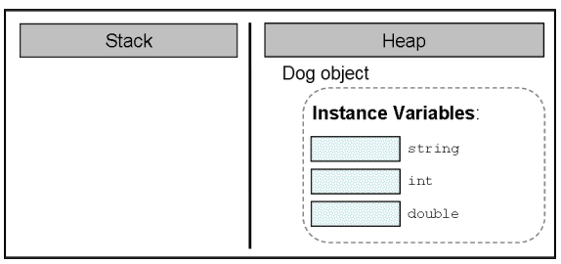
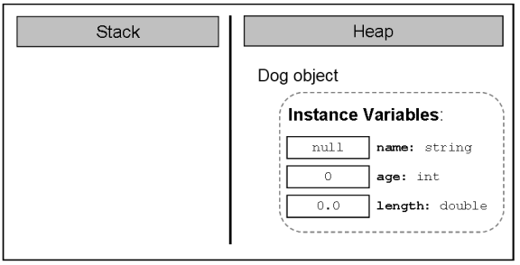
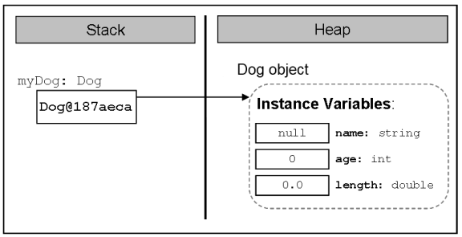
Calling a Constructor
The only one way to call a constructor in C# is through the keyword new. It allocates memory for the new object (in the stack or in the heap, depending on whether the object is a value type or a reference type), resets its fields to zero, calls their constructors (or chain of constructors, formed in succession), and at the end returns a reference to the newly created object.
First, memory is allocated for the object
Next, its fields (if any) are initialized with the default values for their respective types
If the creation of the new object is successfully completed, the constructor returns a reference to it, which is assigned to the variable myDog, from class type Dog

Slide 43
Declaring a Constructor
The constructors are similar to methods, but they do not have a return type (therefore we called them pseudo-methods).
In C# it is mandatory that the name of every constructor matches the name of the class in which it resides – <class_name>.
We should know that, as with methods, the name of the constructor is always followed by round brackets – "(" and ")".
In (C#) it is not allowed to declare a method whose name matches the name of the class (hence the name of the constructors). If nevertheless, a method is declared with the class name, this will cause a compilation error.

Slide 44
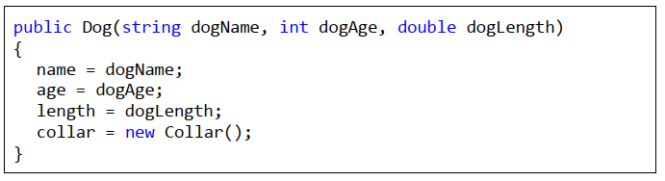
Declaring a Constructor with Parameters

Slide 45
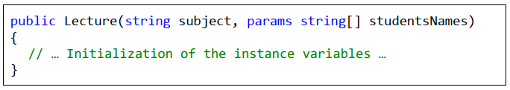

Constructor with Variable Number of Arguments

Slide 46
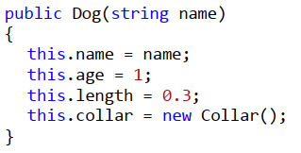
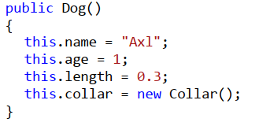
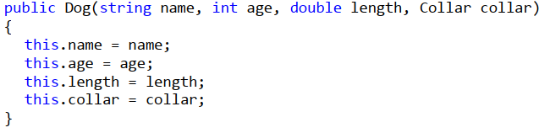
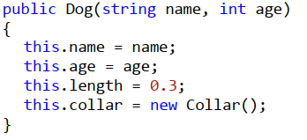
Constructor Overloading
Creating constructors with different signatures is called constructor overloading.

Slide 47
Reusing Constructors
Depending on the needs for creating objects of our class, we can declare different variants of the constructors.
It is easy to notice that a large part of the constructor code is repeated. This leads us to the question whether there is an alternative way for a constructor, which is already doing an initializing, to be reused by the others to perform the same initialization.
In C# a mechanism exists through which one constructor can call another one declared in the same class. This is done again with the keyword this, but used in another syntax structure in declaring the constructors:

Slide 48
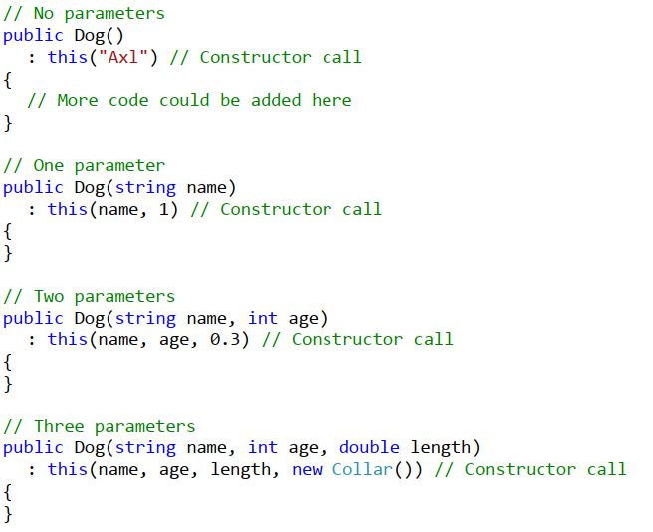
Reusing Constructors

Slide 49
Properties
In the world of object-oriented programming there is an element of the classes called property, which is somewhere between a field and a method and serves to better protect the state in the class.
In some languages for object-oriented programming, like C#, Delphi / Pascal, Visual Basic, Python, JavaScript, and others, the properties are a part of the language, i.e. there is a special mechanism to declare and use them.
Other languages like Java do not support the property concept and for this purpose the programmers should declare a pair of methods (for reading and modifying the property) to provide this functionality.

Slide 50
Properties – Encapsulation of Fields
The main objective of the properties is to ensure the encapsulation of the state of the class in which they are declared, i.e. to protect the class from falling into invalid state.
Encapsulation is hiding of the physical representation of data in one class so that if we subsequently change this presentation, it will not reflect on other classes, which use this class.
Though the C# syntax this is done by declaring the fields (physical presentation of data) with possibly the most limited level of visibility (mostly with the modifier private) and declaring that access to these fields (reading and modifying) is to take place only through special accessor methods.

Slide 51
Properties – Encapsulation of Fields
Live Demo – Points …

Slide 52
Static Classes and Static Members
We call an element static when it is declared with the modifier static.
In C# we can declare fields, methods, properties, constructors and classes as static.
Formally speaking, a static member of the class is every field, property, method or other member, which has a static modifier in its declaration.
That means that fields, methods and properties, marked as static, belong to the particular class rather than to any particular object of the given class.
Therefore, when we mark a field, method or property as static, we can use them without creating any object of the given class. All we need is to have access (visibility) to the class so that we can call the object’s static methods or its static fields and properties.

Slide 53
Static fields
Live demo – Static dog count …

Slide 54
Static Methods
Like static fields, we declare a method as static if we want it to be associated only with the class and not with a particular class object.

Slide 55
Static Classes
For complete understanding we have to explain that we can also declare classes as static. Similar to static members, a class is static, when the keyword static is used in its declaration.
When a class is declared as static, it is an indication that this class contains only static members (i.e. static fields, methods, properties) and cannot be instantiated.

Slide 56
Structures
In C# and .NET Framework there are two implementations of the concept of "class" from the object-oriented programming: classes and structures.
Classes are defined through the keyword class while the structures are defined through the keyword struct. The main difference between a structure and a class is that:
Classes are reference types (references to some address in the heap which holds their members).
Structures (structs) are value types (they directly hold their members in the program execution stack).

Slide 57
Structures
Live demo – PointStruct …

Slide 58
Class or Structure?
Use structures to hold simple data structures consisting of few fields that come together. Examples are coordinates, sizes, locations, colors, etc. Structures are not supposed to have functionality inside (no methods except simple ones like ToString() and comparators). Use structures for small data structures consisting of set of fields that should be passed by value.
Use classes for more complex scenarios where you combine data and programming logic into a class. If you have logic, use a class. If you have more than few simple fields, use a class. If you need to pass variables by reference, use a class. If you need to assign a null value, prefer using a class. If you prefer working with a reference type, use a class.
Classes are used more often than structures. Use structs as exception, and only if you know well what are you doing!

Slide 59
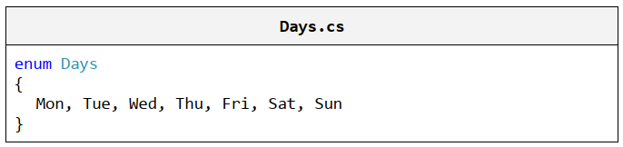


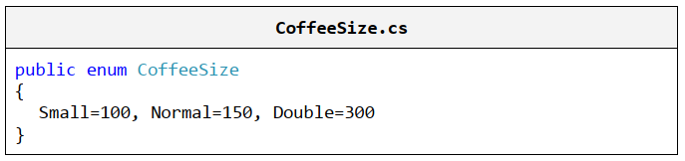
Enumerations
Enumeration is a structure, which resembles a class but differs from it in that in the class body we can declare only constants. Enumerations can take values only from the constants listed in the type. An enumerated variable can have as a value one of the listed in the type constants but cannot have value null.

Slide 60
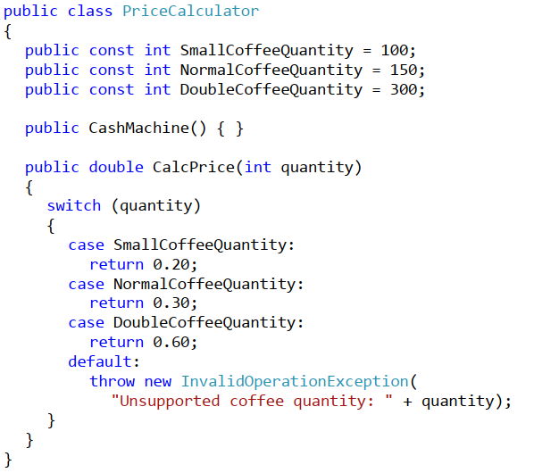
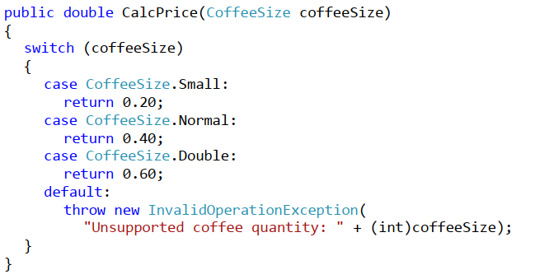
Use of Enumerations

Slide 61
Generics

Slide 62
Exercises 1
1. Define a class Student, which contains the following information about students: full name, course, subject, university, e-mail and phone number.
2. Declare several constructors for the class Student, which have different lists of parameters (for complete information about a student or part of it). Data, which has no initial value to be initialized with null. Use nullable types for all non-mandatory data.
3. Add a static field for the class Student, which holds the number of created objects of this class.
4. Add a method in the class Student, which displays complete information about the student.
5. Modify the current source code of Student class so as to encapsulate the data in the class using properties.
6. Write a class StudentTest, which has to test the functionality of the class Student.

Slide 63
Exercises 2
8. Define a class, which contains information about a mobile phone: model, manufacturer, price, owner, features of the battery (model, idle time and hours talk) and features of the screen (size and colors).
9. Declare several constructors for each of the classes created by the previous task, which have different lists of parameters (for complete information about a student or part of it). Data fields that are unknown have to be initialized respectively with null or 0.
10. To the class of mobile phone in the previous two tasks, add a static field nokiaN95, which stores information about mobile phone model Nokia N95. Add a method to the same class, which displays information about this static field.
11. Add an enumeration BatteryType, which contains the values for type of the battery (Li-Ion, NiMH, NiCd, …) and use it as a new field for the class Battery.
12. Add a method to the class GSM, which returns information about the object as a string.
13. Define properties to encapsulate the data in classes GSM, Battery and
Display.
14. Write a class GSMTest, which has to test the functionality of class GSM. Create few objects of the class and store them into an array. Display information about the created objects. Display information about the static field nokiaN95.

Slide 64
Exercises 3
15. Create a class Call, which contains information about a call made via mobile phone. It should contain information about date, time of start and duration of the call.
16. Add a property for keeping a call history – CallHistory, which holds a list of call records.612 Fundamentals of Computer Programming with C#
17. In GSM class add methods for adding and deleting calls (Call) in the archive of mobile phone calls. Add method, which deletes all calls from the archive.
18. In GSM class, add a method that calculates the total amount of calls (Call) from the archive of phone calls (CallHistory), as the price of a phone call is passed as a parameter to the method.
19. Create a class GSMCallHistoryTest, with which to test the functionality of the class GSM, from task 12, as an object of type GSM. Then add to it a few phone calls (Call). Display information about each phone call.
Assuming that the price per minute is 0.37, calculate and display the total cost of all calls. Remove the longest conversation from archive with phone calls and calculate the total price for all calls again. Finally, clear
the archive.

Slide 65
Exercises 4
20. There is a book library. Define classes respectively for a book and a library. The library must contain a name and a list of books. The books must contain the title, author, publisher, release date and ISBN-number.
In the class, which describes the library, create methods to add a book to the library, to search for a book by a predefined author, to display information about a book and to delete a book from the library.
21. Write a test class, which creates an object of type library, adds several books to it and displays information about each of them. Implement a test functionality, which finds all books authored by Stephen King and deletes them. Finally, display information for each of the remaining books.

